Slide 1
Analyses Involving Categorical Dependent Variables
Gemma Wallace & Neil Yetz
PSY 653 Module 10 Lab
Apr 15, 2020

Slide 2
Logistic regression
Logistic regression is used when you have a categorical outcome
Uses a logit link to link the categorical outcome with the predictor variables
You can derive interpretable odds ratios from logistic regression

Slide 3
Odds Ratios
Probability and odds ratios are fundamental for logistic regression
A proportion can serve as an estimate for the probability (aka risk) of an event
E.g., If 75% of students who studied received a passing grade, the probability, or risk, of a randomly sampled student who studied getting a passing grade is 0.75
Risk Ratios (aka relative risk) allow us to compare probability or risk across multiple groups
RR = (Probability of group 1/probability of group 2) → risk of outcome for one group compared to another group
Odds Ratios = another way to describe the likelihood of an event
OR = (chances event will occur)/(chances event will not occur) → odds that the outcome will occur

Slide 4

Load Libraries

Slide 5
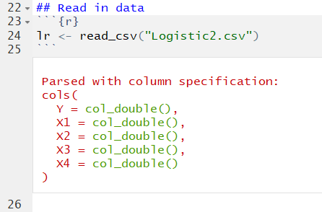
Read in data
This is a simulated dataset with N=164 and 5 variables:
Y: A binary categorical variable (Coded as 0 or 1).
X1: A binary variable (Coded as 0 or 1)
X2: A continuous variable ranging from 0 to 10
X3: A continuous variable ranging from 0 to 5
X4: A continuous variable ranging from 0 to 4

Slide 6
Goals for this activity:
Regress Y on all of the predictor (X) variables using OLS multiple regression and interpret the results.
Regress Y on all of the predictor (X) variables using logistic regression and interpret the results
Compare the results from the two analytic approaches
Though not shown in the demo, remember that it’s good practice to examine descriptives and visualize your data before conducting analyses :)

Slide 7
Part 1: Conduct analyses with OLS Regression

Slide 8
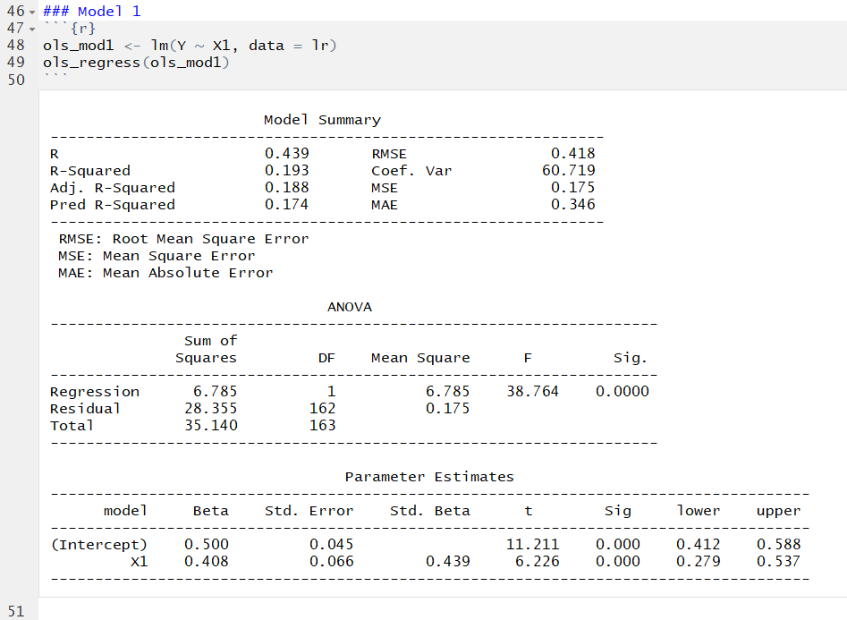
OLS Regression Model 1
Intercept: When X1 is zero, the expected Y is .500.
X1: For every one-unit increase X1, there is an expected .408 increase in Y.
This model explains 19.31% of the variance in Y.
We will use a hierarchical regression approach to build up to the full model that evaluates all of the predictors simultaneously. We’ll compare model R² at each stage. No need to test interactions in this activity.

Slide 9
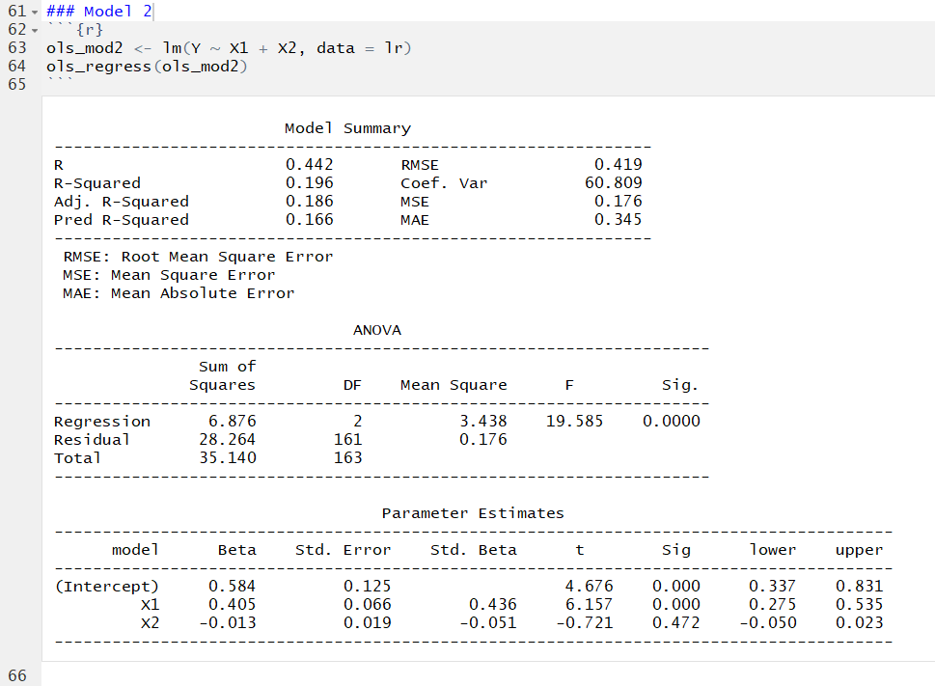
OLS Regression Model 2
Intercept: When all predictors are zero, the expected Y is .584.
X1: Holding all other variables constant; For every one-unit increase X1, there is an expected .405 increase in Y.
X2: Holding all other variables constant; For every one-unit increase X2, there is an expected .013 decrease in Y.
This model explains 19.58% of the variance in Y. This is not much higher than Model 1 (19.3%)

Slide 10
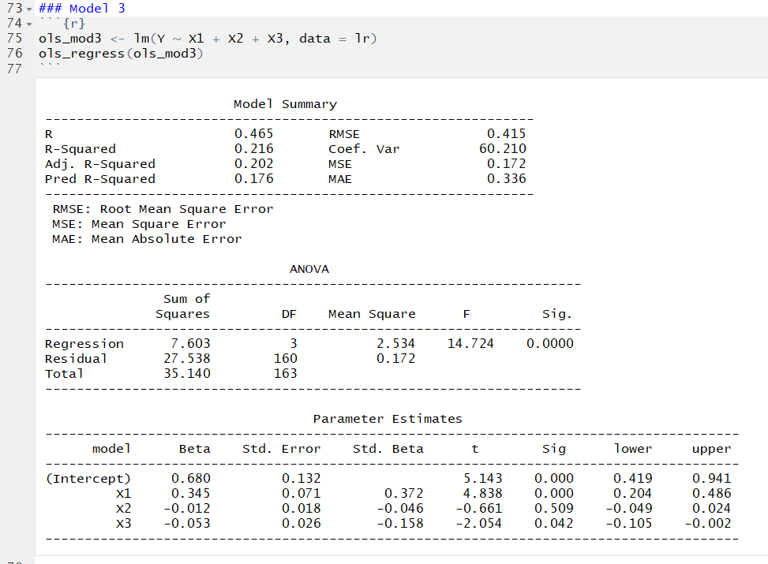
OLS Regression Model 3
Intercept: When all predictors are zero, the expected Y is .680.
X1: Holding all other variables constant; For every one-unit increase X1, there is an expected .345 increase in Y.
X2: Holding all other variables constant; For every one-unit increase X2, there is an expected -.0.12 increase in Y.
X3: Holding all other variables constant; For every one-unit increase X3, there is an expected -.053 increase in Y.
This model explains 21.64% of the variance in Y. This is not much higher than Model 2 (19.58%).

Slide 11

OLS Regression Model 4
Intercept: When all predictors are zero, the expected Y is .316.
X1: Holding all other variables constant; For every one-unit increase X1, there is an expected .287 increase in Y.
X2: Holding all other variables constant; For every one-unit increase X2, there is an expected -.013 increase in Y.
X3: Holding all other variables constant; For every one-unit increase X3, there is an expected -.028 increase in Y.
X4: Holding all other variables constant; For every one-unit increase X4, there is an expected .115 increase in Y.
This model explains 26.87% of the variance in Y. This is a bit higher than Model 3 (21.64%).

Slide 12
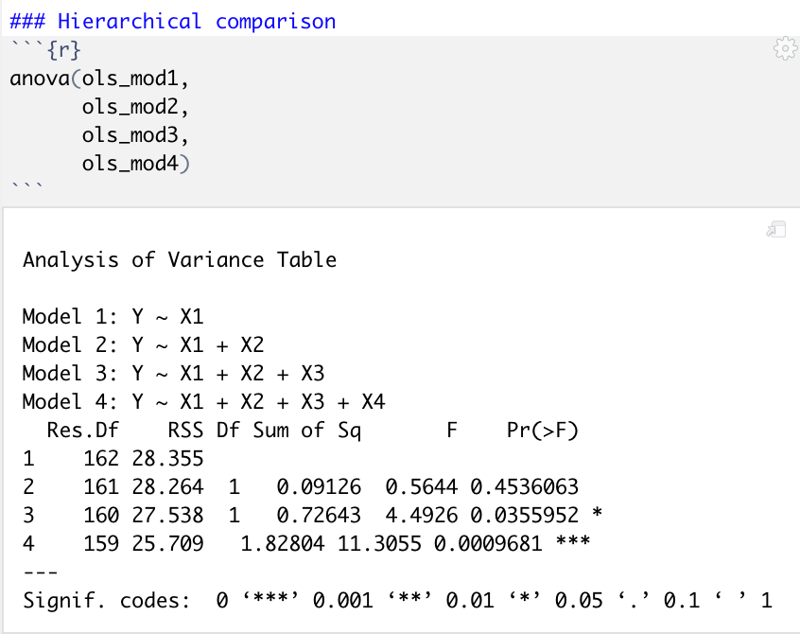
Summary of OLS model comparisons
Percent variance explained in Y:
Model 1 (Y~X1) = 19.31
Model 2 (Y~X1+X2) = 19.58
Model 3 (Y~X1+X2+X3) = 21.64
Model 4(Y~X1 + X2 + X3 + X4) = 26.87
While the effect size (i.e., R² difference) is most important, you can also test for significant improvements to model fit using anova().

Slide 13
Part 2: Conduct analyses with Logistic Regression

Slide 14
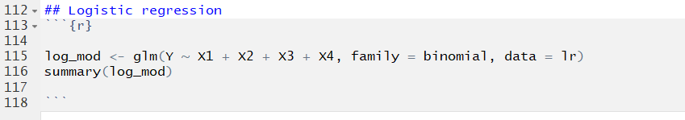
The glm() function
family = binomial tells the model that the outcome variable is binary (zeros and ones)

Slide 15
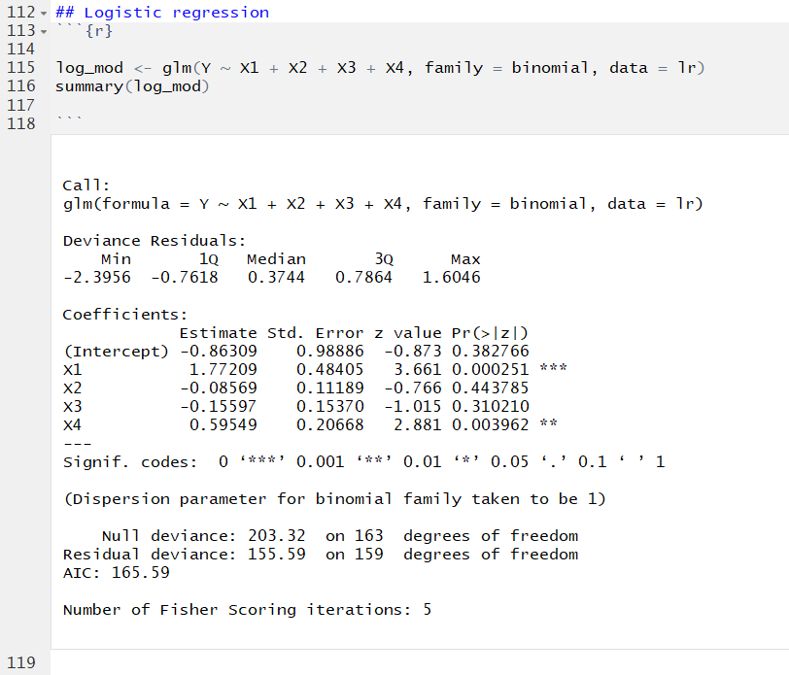
Logistic regression model
The model displays the log odds of each predictor variable (While controlling for all other predictors in the model) on the outcome of Y.
We can see that X1 and X4 are statistically significant. However, to have a better interpretation of each with odds ratios, we need to exponentiate the coefficients.
Note: we don’t need to build up the model step-by-step here because we can back-calculate the variance explained by each added variable (shown later!)

Slide 16
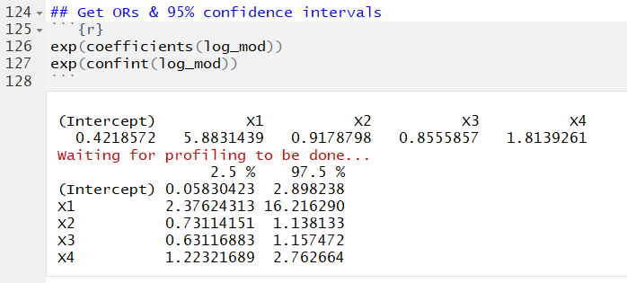
Exponentiate the coefficients and confidence intervals to obtain interpretable Odds ratios.

Slide 17
Exponentiate the coefficients and confidence intervals to obtain interpretable odds ratios
ODDS RATIOS
CONFIDENCE INTERVALS

Slide 18
Logistic regression model interpretations
Intercept: When all of the X variables are zero, the odds are .421 times as likely of developing the outcome of Y (Or we can take the inverse and state the they are 2.38 times as likely NOT to develop the outcome of Y). This is not statistically significant.
X1 (Binary): After controlling for all variables in the model, Those coded as 1 are 5.88 times as likely to develop the outcome of Y as compared to those coded 0. This is statistically significant.
X2 (Continuous): After controlling for all variables in the model, For every one unit increase in X2, there is an expected increase of 0.918 times of developing Y (Or we can take the inverse and state that for every one unit increase in X2, there is a 1.09 increase in the odds of NOT developing the outcome of Y). This is not statistically significant.
X3 (Continuous): After controlling for all variables in the model, For every one unit increase in X3, there is an expected increase of 0.856 times in the odds of developing Y (Or we can take the inverse and state that for every one unit increase in X2, there is a 1.17 increase in the odds of NOT developing the outcome of Y). This not is statistically significant.
X4 (Continuous): After controlling for all variables in the model, For every one unit increase in X4, there is an expected increase of 1.81 times in the odds of developing Y. This is statistically significant.
In logistic regression, an effect is significant if the confidence interval does not contain 1 (not zero, as in ols analyses; odds of 1 represent equal odds)

Slide 19
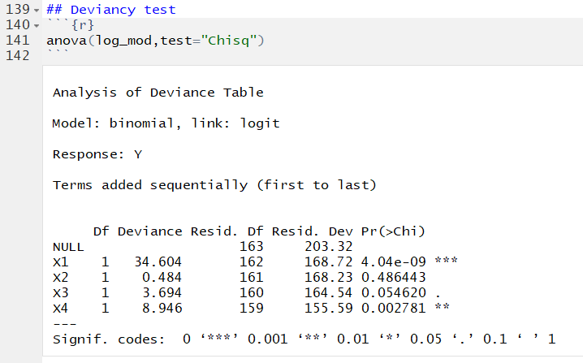
Logistic regression: Examine deviance between models
This compares deviance, an estimate of model fit, between each model and the null model. The values represent:
X1 = model with just X1 vs. NULL model
X2 = model with X1 + X2 vs. NULL model
X3 = model with X1 + X2 + X3 vs. NULL model
X4 = model with X1 + X2 + X3 + X4 vs. NULL model
These comparisons tell us whether adding information to the null model leads to better prediction. In this case, the X2 and X3 models do not significantly improve model fit.

Slide 20
Logistic regression: McFadden’s R²
On the previous slide, we showed how deviance comparisons give information about how each subsequent model compares to the null model.
McFadden’s R² allows you to estimate the percent variance explained by each model, which can serve as an effect size.
McFadden R² = 1-(Deviance model/Deviance Null)

Slide 21
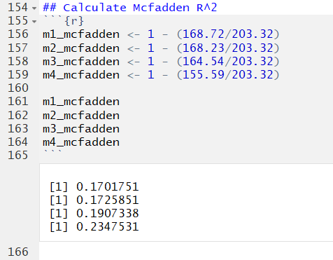
Logistic regression: McFadden’s R²
You can use the McFadden’s R² values to compare changes in the percent of variance in Y for the addition of each variable, like we do in OLS hierarchical regression comparisons:
Percent variance explained in Y:
Model 1 (Y~X1) = 17.02
Model 2 (Y~X1+X2) = 17.26
Model 3 (Y~X1+X2+X3) = 19.07
Model 4(Y~X1 + X2 + X3 + X4) = 23.47
Notes:
Odd that these were quite different in this data but essentially identical in the bac data? Did I make a mistake in mine?

Slide 22
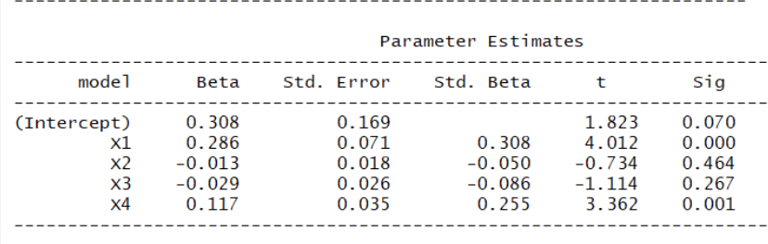
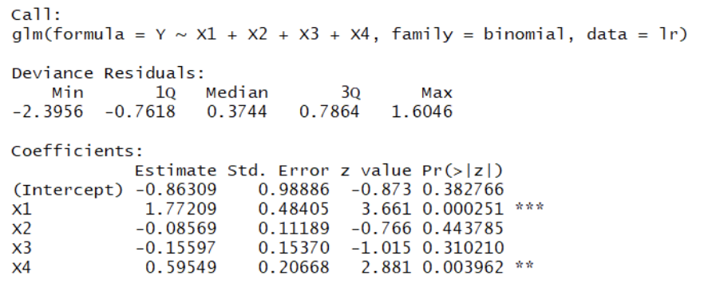
Part 3: Compare results from OLS vs. logistic regression
OLS regression
Logistic regression
Percent variance explained in Y:
Model 1 (Y~X1) = 19.31
Model 2 (Y~X1+X2) = 19.58
Model 3 (Y~X1+X2+X3) = 21.64
Model 4(Y~X1 + X2 + X3 + X4) = 26.87
Percent variance explained in Y:
Model 1 (Y~X1) = 17.02
Model 2 (Y~X1+X2) = 17.26
Model 3 (Y~X1+X2+X3) = 19.07
Model 4(Y~X1 + X2 + X3 + X4) = 23.47
While the results are similar, logistic regression is preferred because it provides concrete, meaningful interpretations.

